Slide 1
An Introduction to the Healthy Relationships Advisory Forum
Cath Bennett Fozia Drysdale
Education Safeguarding Lead Practice Manager FJC
07729623489

Slide 2
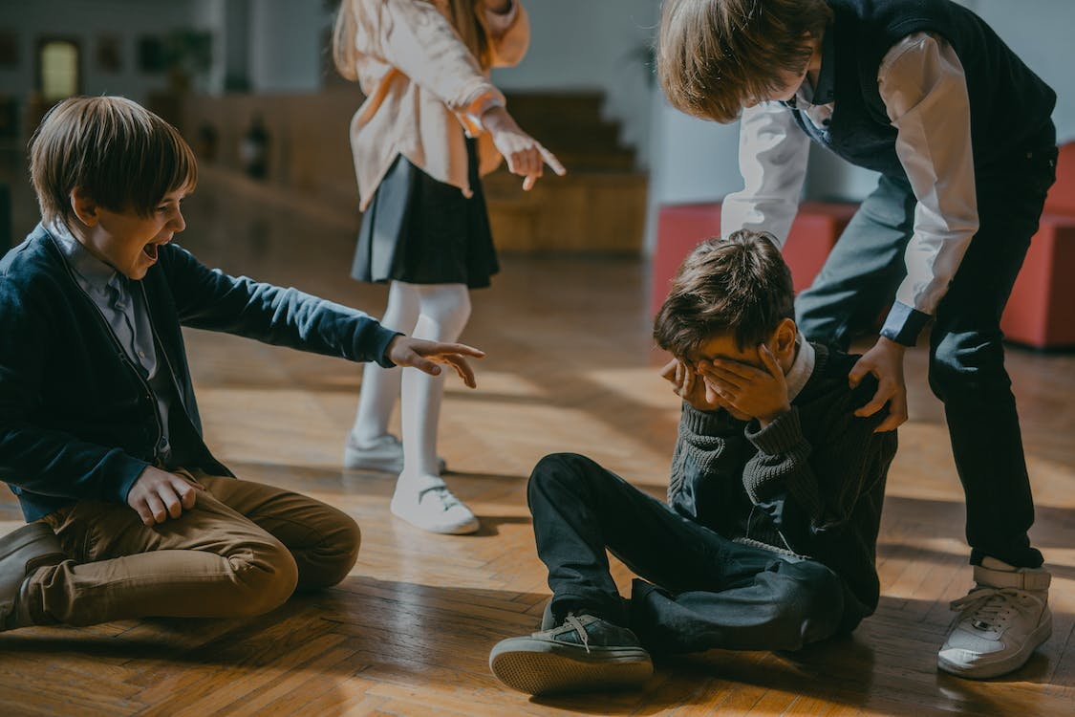
What is the HRAF?
A small panel of professionals from non-statutory services who have knowledge and experience within the areas or relationships, hate crime/incidents, and domestic abuse.
An opportunity for schools and colleges to discuss concerns about a child or young person’s behaviour within the relationships they have.
To provide the school or college with advice and strategies, signpost them to potential support services
Not Age limited so accessible for all ages to discuss concerns

Slide 3
Why do we need it?
A progressive step on from last year’s work following the OFSTED report on Sexual Abuse in Schools.
Schools are increasingly identifying relationship abuse (or the early signs of it) which may not meet threshold for statutory intervention.
Prevention is better than cure.
There is a gap in young people involved in relationship abuse being discussed in a low-level multi-agency forum. For adults we have MARAC
Croydon is the highest London Borough for DA incidents.

Slide 4
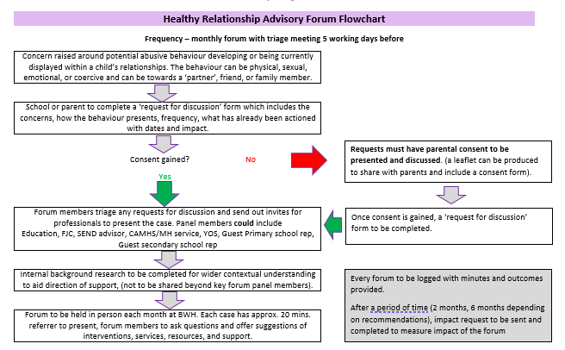
How Does it Work?

Slide 5
REFERRALS
Current concerns
Behavioural history
Family history
Young person’s views
Interventions already tried
Current risks
What do they want from the Forum?
REMEMBER to consider any additional needs and diagnosis when exploring the presenting behaviour.

Slide 6
Structure of the Forum
There will be a triage meeting approx 5 days before (hence the deadline).
School will present the case to the panel members (similar to FAP and Primary Inclusion)
There will be an open discussion and proposal for what school can/need to do next
Approx 3-6 months after, school will be asked to complete a review to help measure the impact of recommendations and support in developing future panels.
Panel members could include:
Cath – Education Safeguarding Lead and Chair
Fozia – FJC,
Haydar – Prevent Manager
Zoe – Education Advisor Health and Well-being
Deborah – Senior AIO
Possible Primary an secondary school guest

Slide 7
What could the support look like?
The forum aims to provide support in a variety of ways and will be case dependent. The possibilities are
advice on developing the school relationships curriculum
Additional strategies/resources to try with the child or young person
Signposting to Croydon based or wider services
Advice on direct work that school can be completed individually with the child or young person
Referral to MARAC (if close to adult age)
Advise to refer to SPOC/MASH and/or police
This does not replace existing work the school or college is already providing, or work from EH/CSC
This does not replace necessary referrals to EH/CSC

Slide 8
What are the Desired Outcomes?
Short term -
Empower schools with new tools and resources and educate YP
Medium term -
Reduce the need for referrals to statutory services
Long term - Prevent future perpetrators of DASV

Slide 9
Who can refer?
Schools and colleges
Social workers
Parents

Slide 10
Referral Deadline | Triage Meeting CB and FD | Meeting Date
Fri 3.3.2023 | Mon 6.3.2023 @FJC | Mon 13.3.2023 Via Teams
Fri 31.3.2023 | Mon 3.4.2023 @FJC | Tues 18.4.2023 Via Teams
Mon 1.5.2023 | Tue 2.5.2023 @FJC | Mon 8.5.2023 Via Teams
Fri 2.6.2023 | Mon 5.6.2023 @FJC | Mon 12.6.2023 Via Teams
Fri 30.6.2023 | Mon 3.7.2023 @FJC | Mon 10.7.2023 Via Teams

